Slide 1
Module 4 – Understanding ways of doing research
Analysing quantitative data
How do we make sense of data?
WORKSHOP PRESENTATION

Slide 2
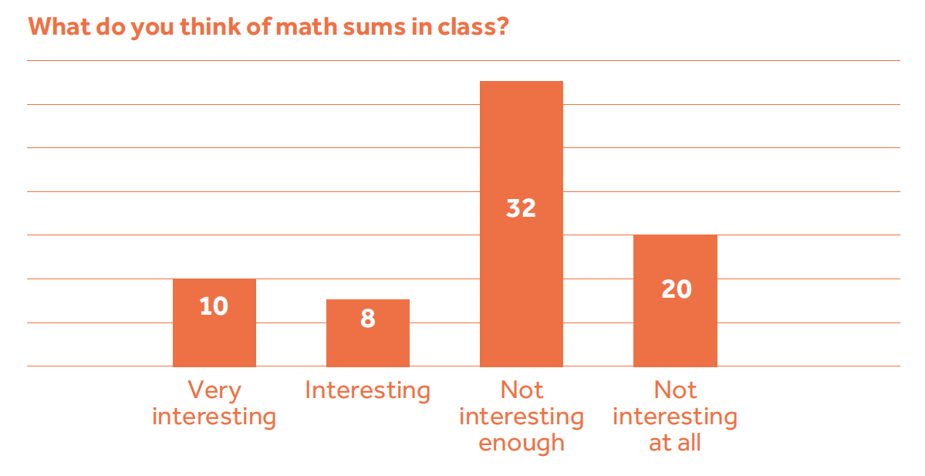
Module 4 – Understanding ways of doing research

Slide 3
Module 4 – Understanding ways of doing research

Slide 4
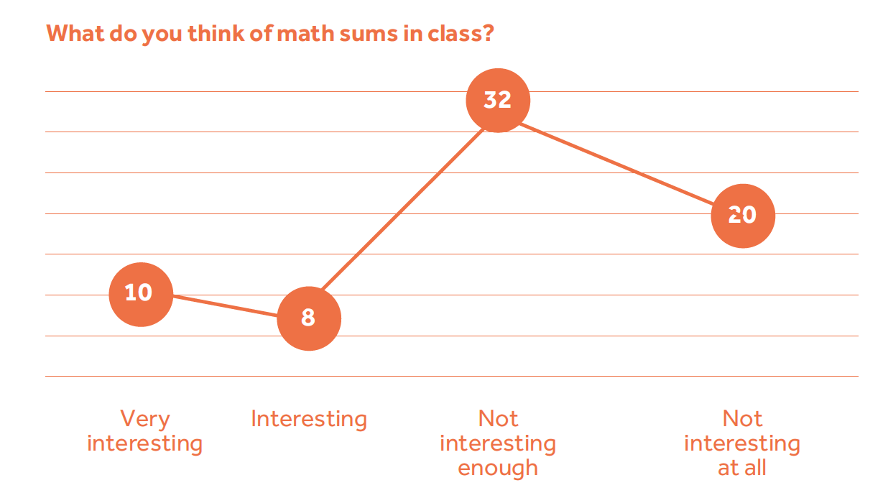
Module 4 – Understanding ways of doing research

